Slide 1
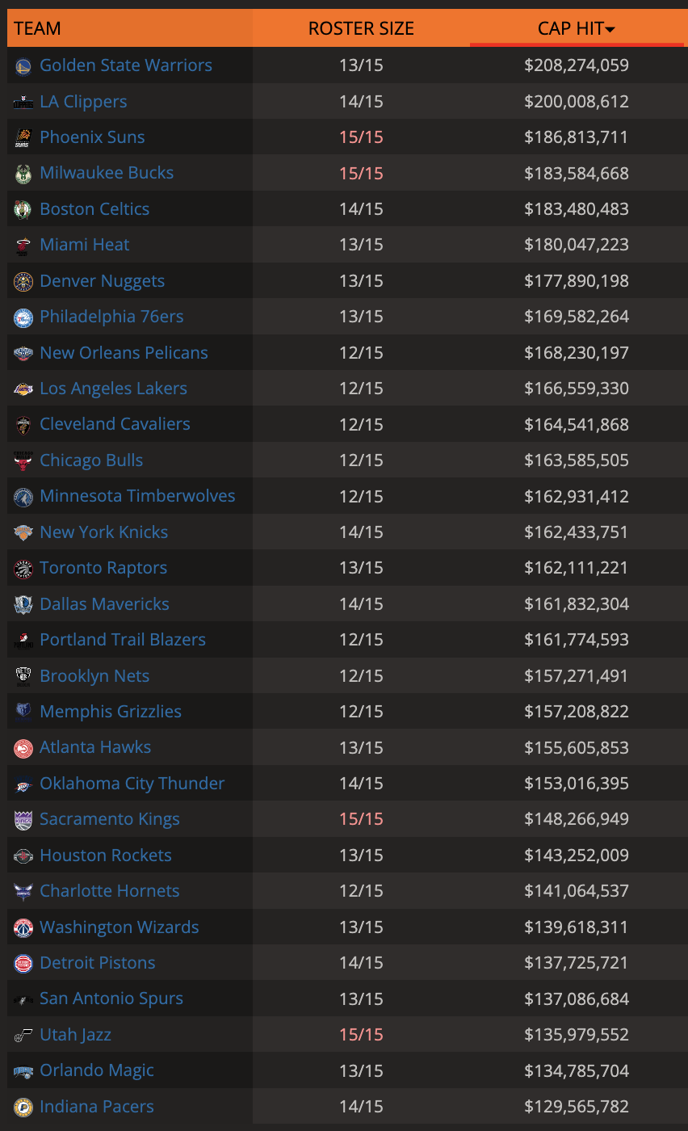
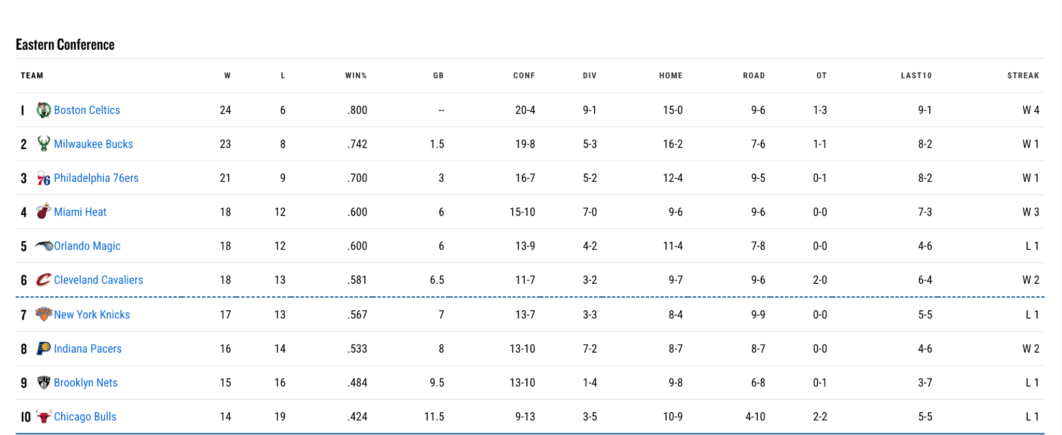
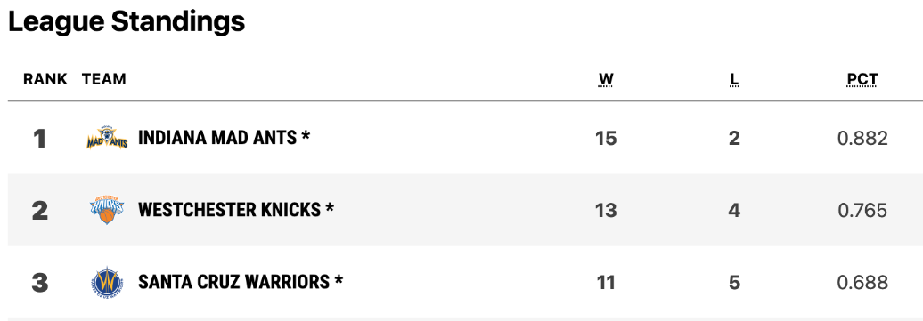
Pacers are not - and should not - play the same game as everyone else!
30th in salary (via Salary Swish)...
1st in G-League…
NBA play-in spot!

Slide 2
Where do good players come from?
MLB: Players are promoted through a series of farm teams, and skill development occurs at all levels
EPL: Players are recruited to academies and prepared for promotion within the organization. Player promotion centers around young stars from lower leagues.
NFL: Players are selected through the draft based on years of college performance. Players are developed through increasing repetitions and game opportunities.
NHL: Players are developed primarily in Junior, Collegiate, and Minor Levels. Player performance is evaluated with league equivalency to demonstrate proficiency.
NBA: Skilled players are acquired through free-agency and lottery draft picks. Top players are expected to instantly fill a role in an NBA squad.
NBA rosters should be built from within, and players should develop in an organization.

Slide 3


Follow the Tampa Bay Rays Model
Build through the draft
Build through the draft
Develop young pitchers using biomechanics & high-tech pitch design
Develop young shooters using biomechanics & high-tech shot design
Avoid expensive free agency
Avoid expensive free agency
Trade young pitchers
Trade young shooters
Pitchers fetch a premium
Shooters fetch a premium
Driveline Baseball
Mechanics of the Jump Shot
Jump Shot Analysis
Biomechanical Adjustments
The MVP Machine
P3 Data Development

Slide 4
Hunt the bargain bin
Weaponize all assets
Competitive Advantage
Acquire players who have struggled to find minutes or carve their niche.
Trade young stars before they hit free-agency.
Develop Players & Promote From Within.
Engineer Players
Draft-Prestige Shooters
Demonstrated Success
Physics doesn’t determine a good 3pt % around ~35% - players can improve from 3pt with data-driven assistance.
Acquire players who were lauded for shooting during the draft.
Extend Mad Ants/Pacers with beneficial Dollar-Per-WAR playing the Pacers offense.

Slide 5
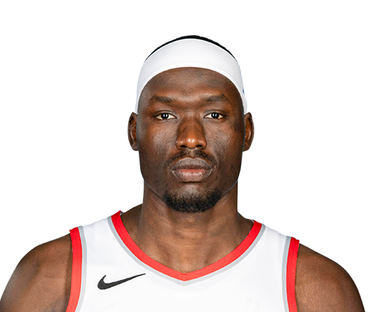
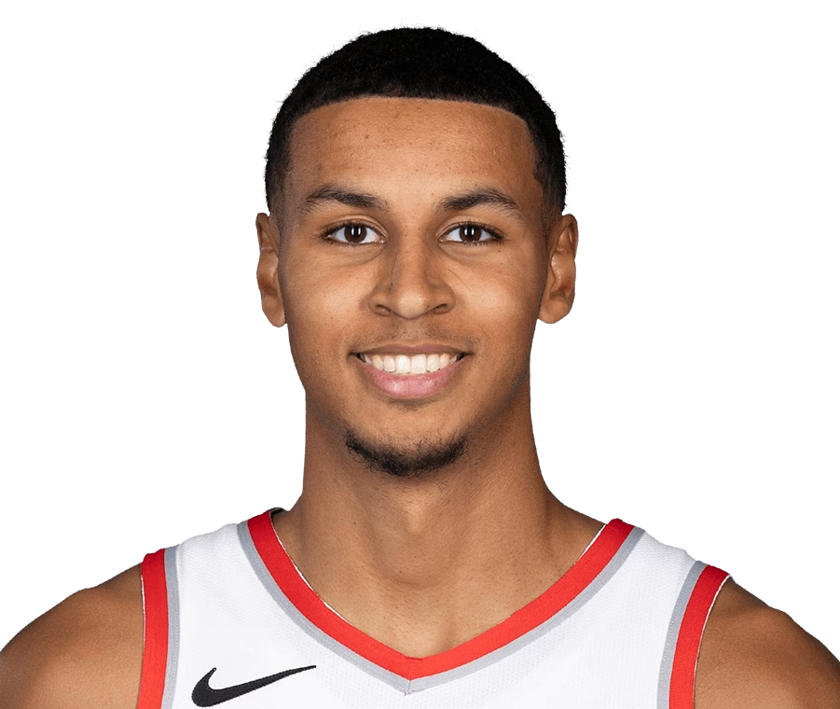
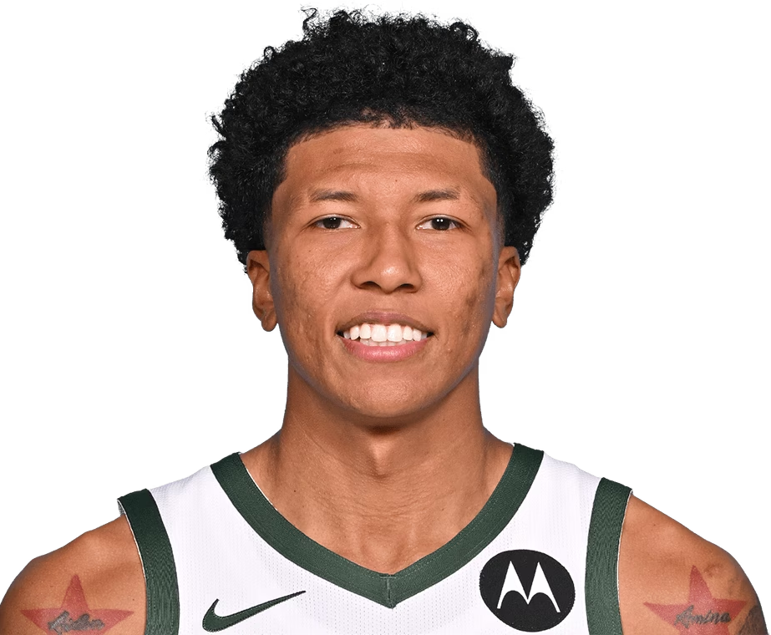
Duop Reath
Kris Murray
MarJon Beauchamp
Shooting effectiveness
Positional Upgrade
Low on depth chart - DTD w/ injuries
Shooting effectiveness
Fmr. 1st Rounder - More Years of Team Control
Low on depth chart
Shooting effectiveness
Fmr. 1st Rounder - More Years of Team Control
Low on depth chart
Source: DARKO

